Slide 1
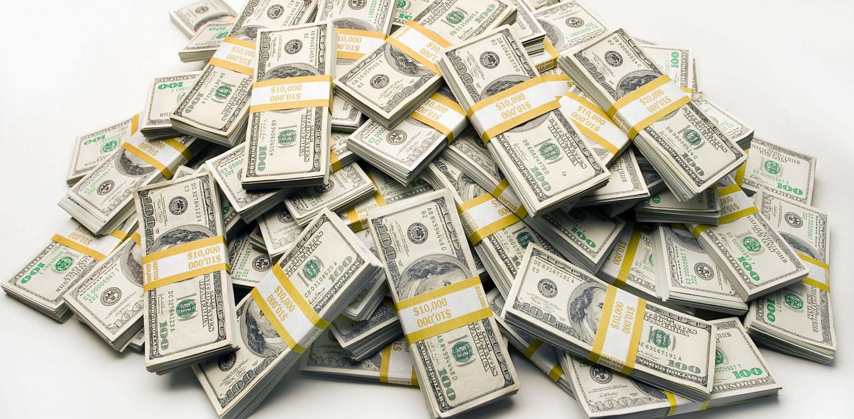
image from abcnews.go.com

Slide 2
The Mosaic Covenant between God and Israel included commands and promises about tithing.
Israelites gave back to God through the religious workers.
As God blessed them with provision, they gave back 10% of that provision [their income].
In the New Covenant, tithing is not mentioned; but tithing goals remain:
show God reverence;
remember our dependence on God and celebrate his provision;
support religious workers and other ministry expenses;
help the needy.

Slide 3
Luke 16.10-13 NET: “The one who is faithful in a very little is also faithful in much, and the one who is dishonest in a very little is also dishonest in much.
If then you haven't been trustworthy in handling worldly wealth, who will entrust you with the true riches? And if you haven't been trustworthy with someone else's property, who will give you your own?
No servant can serve two masters, for either he will hate the one and love the other, or he will be devoted to the one and despise the other. You cannot serve God and money.”

Slide 4
Luke 16.10-13 NET: “The one who is faithful in a very little is also faithful in much, and the one who is dishonest in a very little is also dishonest in much.
If then you haven't been trustworthy in handling worldly wealth, who will entrust you with the true riches? And if you haven't been trustworthy with someone else's property, who will give you your own?
No servant can serve two masters, for either he will hate the one and love the other, or he will be devoted to the one and despise the other. You cannot serve God and money.”

Slide 5
1 Timothy 6.17-19 NET: Command those who are rich in this world's goods not to be haughty or to set their hope on riches, which are uncertain, but on God who richly provides us with all things for our enjoyment.
Tell them to do good, to be rich in good deeds, to be generous givers, sharing with others.
In this way they will save up a treasure for themselves as a firm foundation for the future and so lay hold of what is truly life.

Slide 6
Mark 12.41-44 NET: Then he sat down opposite the offering box, and watched the crowd putting coins into it.
Many rich people were throwing in large amounts. And a poor widow came and put in two small copper coins, worth less than a penny.
He called his disciples and said to them, “I tell you the truth, this poor widow has put more into the offering box than all the others. For they all gave out of their wealth. But she, out of her poverty, put in what she had to live on, everything she had.”

Slide 7
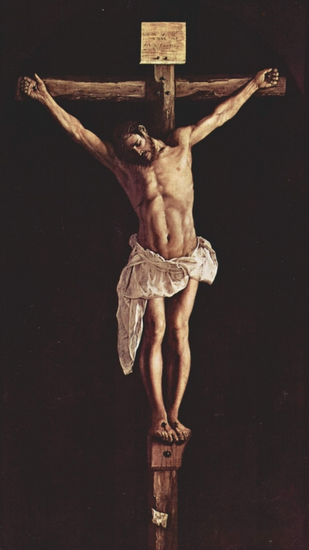
John 13.34 NET: “Just as I have loved you, you also are to love one another.”
Francisco de Zurbaran; Vanderbilt.edu

Slide 8
2 Corinthians 8.1-4 NET: Now we make known to you, brothers and sisters, the grace of God given to the churches of Macedonia, that during a severe ordeal of suffering, their abundant joy and their extreme poverty have overflowed in the wealth of their generosity.
For I testify, they gave according to their means and beyond their means. They did so voluntarily, begging us with great earnestness for the blessing and fellowship of helping the saints.

Slide 9
2 Corinthians 8.10-12 NET: So here is my opinion on this matter: It is to your advantage, since you made a good start last year both in your giving and your desire to give, to finish what you started, so that just as you wanted to do it eagerly, you can also complete it according to your means.
For if the eagerness is present, the gift itself is acceptable according to whatever one has, not according to what he does not have.

Slide 10
2 Corinthians 8.13-15 NET: For I do not say this so there would be relief for others and suffering for you, but as a matter of equality.
At the present time, your abundance will meet their need, so that one day their abundance may also meet your need, and thus there may be equality, as it is written: “The one who gathered much did not have too much, and the one who gathered little did not have too little.”

Slide 11
2 Corinthians 9.6-11a NET: My point is this: The person who sows sparingly will also reap sparingly, and the person who sows generously will also reap generously. Each one of you should give just as he has decided in his heart, not reluctantly or under compulsion, because God loves a cheerful giver. And God is able to make all grace overflow to you so that because you have enough of everything in every way at all times, you will overflow in every good work. Just as it is written, “He has scattered widely, he has given to the poor; his righteousness remains forever.” Now God who provides seed for the sower and bread for food will provide and multiply your supply of seed and will cause the harvest of your righteousness to grow. You will be enriched in every way so that you may be generous on every occasion…

Slide 12
2 Corinthians 9.6, 8, 10-11a NET: My point is this: The person who sows sparingly will also reap sparingly, and the person who sows generously will also reap generously…
And God is able to make all grace overflow to you so that because you have enough of everything in every way at all times, you will overflow in every good work...
Now God who provides seed for the sower and bread for food will provide and multiply your supply of seed and will cause the harvest of your righteousness to grow. You will be enriched in every way so that you may be generous on every occasion…

Slide 13
2 Corinthians 9.7, 9 NET: Each one of you should give just as he has decided in his heart, not reluctantly or under compulsion, because God loves a cheerful giver…
Just as it is written [in Psalm 112.9], “He [the man of integrity] has scattered [gifts] widely, he has given to the poor; his righteousness remains forever.”

Slide 14
2 Corinthians 9.11-15 NET: You will be enriched in every way so that you may be generous on every occasion, which is producing through us thanksgiving to God, because the service of this ministry is not only providing for the needs of the saints but is also overflowing with many thanks to God.
Through the evidence of this service they will glorify God because of your obedience to your confession in the gospel of Christ and the generosity of your sharing with them and with everyone. And in their prayers on your behalf they long for you because of the extraordinary grace God has shown to you. Thanks be to God for his indescribable gift!

Slide 15
Acts 20.35 NET: “…remember the words of the Lord Jesus that he himself said, ‘It is more blessed to give than to receive.’”
Understand God’s revelation in the Bible.
Pray earnestly about this issue.
Discern how the Holy Spirit is guiding you.
Give accordingly.

